Slide 1
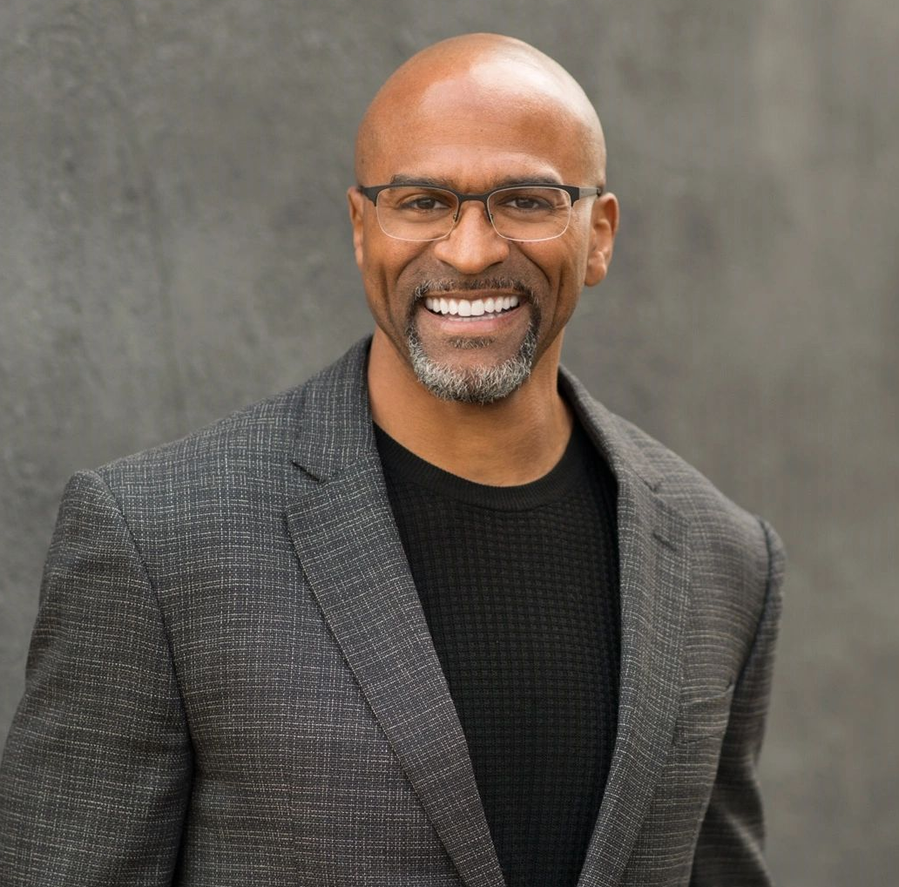

Alex Molden: showcase Videos
Former NFL defensive back who was drafted in the 1st round of the 1996 NFL draft. Played for 8 years as a part of the Saints, Chargers and Lions for 7 different coaches
Currently a personal development and leadership speaker and coach who focuses on strengthening team collaborations, communication and transparency
Leadership formula has given organizations and executives proven solutions to help them build more galvanized teams
Podcast host of "The Shark Effect" (Top 1.5%)
Clients include Microsoft, Converse, McDonald’s, the Atlanta Falcons among many others
Key Takeaways:
Shares roadmaps for developing leadership skills, investing in relationships and overcoming fears – all of which are facets of success
Strengthen team collaborations, communication & transparency using his leadership blueprint
Sample Keynote Topics:
Leadership Foundations
The Dynamics of a Good Team
How to get unstuck when trying to figure out your purpose
How to raise Dragons
ALEX MOLDEN Former NFL Player, Leadership Speaker
Fee: $10,000
*Client is responsible for first class, round-trip airfare, ground transportation, hotel accommodations and incidentals for up to two nights

