Slide 1
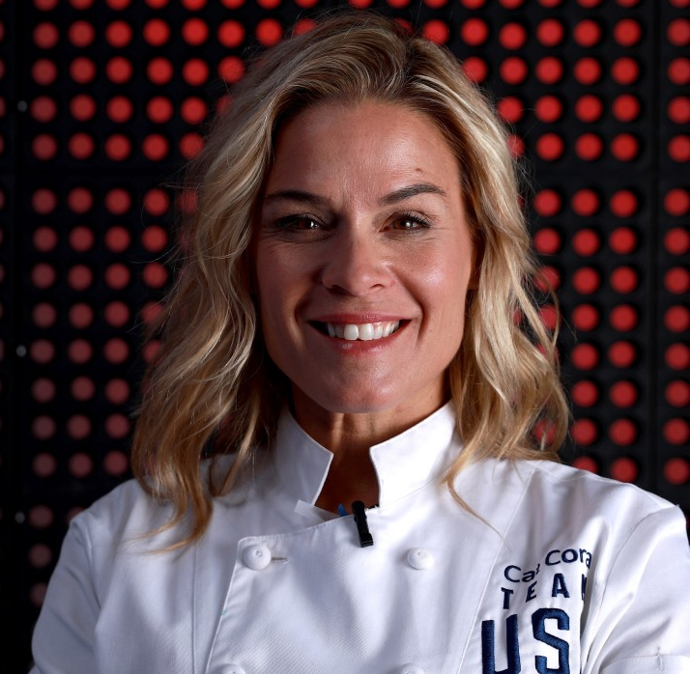
Watch Cat Cora: Cat Talks being a Chef, Restaurateur and Health Expert
World-renowned chef, author, restaurateur, contributing editor, television host and personality, avid philanthropist, health and fitness expert and lifestyle entrepreneur
Trained at the Culinary Institute of America and went on to cook at two 3-star Michelin restaurants in France, has been captivating audiences since she made her TV debut in 1999, as
TV appearances include co-host of Food Network’s Melting Pot with Rocco Di Spirito, host of My Country My Kitchen: Greece, Date Plate, and Fine Living’s Simplify Your Life
Made history when she became the first-ever female Iron Chef on Food Network’s Iron Chef America and again when she became the first female to be indicted into The American Academy of Chefs Culinary Hall of Fame
Featured extensively on a number of television shows, including as co-host on BRAVO's Around the World in 80 Plates, FOX's My Kitchen Rules and ABC’s Family Food Fight
Awarded Bon Appetit Magazine’s “Teacher of the Year Award” in 2006 and was named the Executive Chef of the magazine
Has opened more than 18 restaurants highlighting her platform on health, wellness and sustainability including Cat Cora’s Kitchen, Cat Cora's Taproom, Ocean by Cat Cora in Singapore, Kouzzina by Cat Cora at Disney World, Postino in San Francisco and Mesa Burger with 3 California locations
Southern California Restaurants:
Mesa Burger (Santa Barbara, CA; Goleta, CA; Montecito, CA)
CAT CORA
Fee: On Request
*Client is responsible for business class, round-trip airfare, ground transportation, hotel accommodations and incidentals for up to two nights

