Slide 1
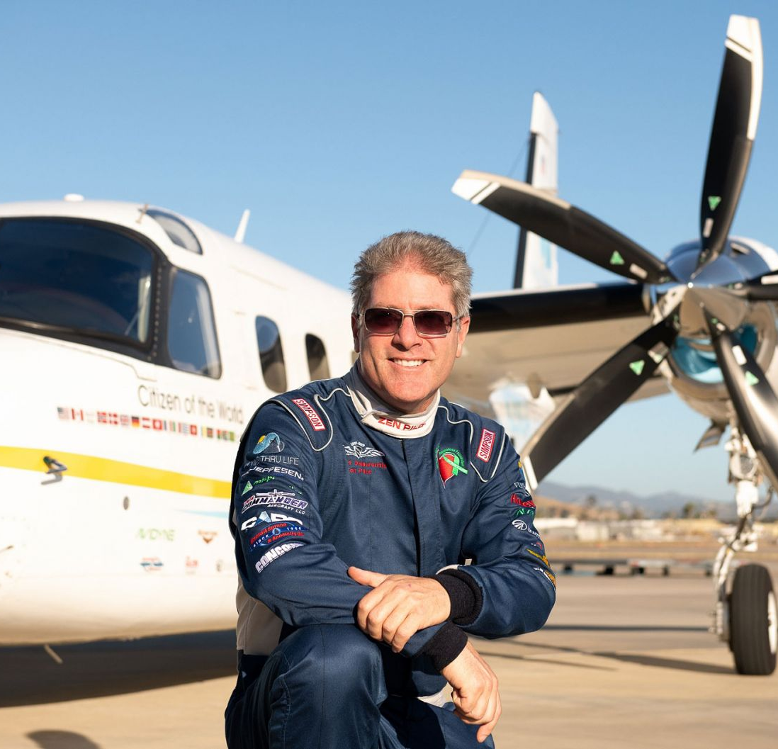
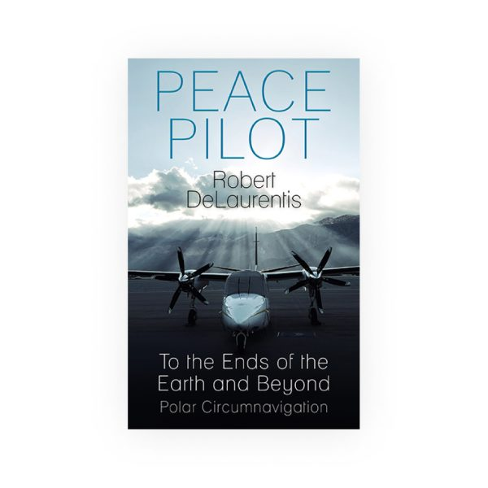



Watch Robert DeLaurentis: Interview
Watch Documentary Trailer: Citizen of the World
Former Naval officer turned pilot Robert DeLaurentis completed a nine-month mission to share peace worldwide by connecting the two places on the planet where peace has always existed — the North and South Poles — with everyone in between.
“Peace Pilot” Robert DeLaurentis is an aviation circumnavigator, author, speaker, pilot, real estate entrepreneur, philanthropist, and Navy Gulf War veteran.
Robert successfully completed an equatorial circumnavigation with a single plane, single-engine, and single pilot across the Atlantic, Pacific, and Indian Oceans to 23 countries in his Piper Malibu Mirage, “Spirit of San Diego.”
He is the founder of the “Citizen of the World for the World” global peace movement to connect humanity through the wonder of flight and the power of courageous action.
KEYNOTE TOPICS:
How to Triage & Survive the “COVID-19 Event
Aviation as Inspiration
How to Grow Your Business and Relationships with Applied Spirituality
Spirit of Adventure: Limitless Flying
Soulful Adventures: Lessons in Life, Flying and Business
Flying to Your Absolute Limits: North and South Poles
Zen Business: Achieve More, Work Less (Business)
Partnering in Business with Spirit
Robert DeLaurentis
Peace Pilot, Inspirational Speaker
Fee Pending
*Client is responsible for roundtrip airfare, ground transportation, hotel accommodations and incidentals for up to two nights

