Slide 1
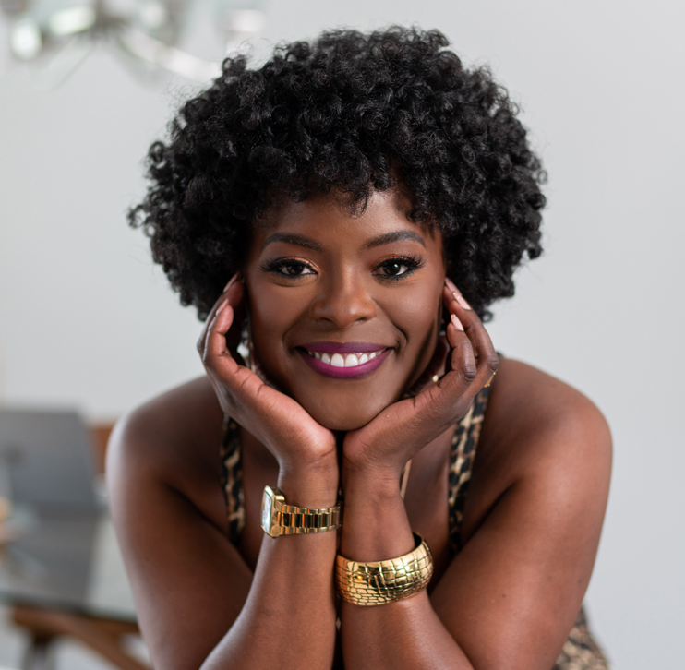
Meet Kiesha Garrison
Watch Kiesha Garrison: Women in Regatta Virtual Event
Praised for her poise and thoughtfulness in front of crowds ranging from Fortune 500 companies to A-list celebrities, community changemakers and beyond
Sought-after broadcast and event host with a signature blend of intentionality, connection and warmth
Creator of YOU Better!, a platform designed to spark deeper personal discovery and self-love
Combines 20 years of experience as a strategic leader at corporations like Time, Inc and Microsoft with her skill as a stand up comedian to shine on-stage and engage audiences
Served as a key partner for events like the Women in Tech Regatta, Microsoft Ready and Include and Resulticks Ignite as well as led insightful interviews with well-known subjects including Will Smith, Lenny Kravitz, Ang Lee and Maritza McClendon
KIESHA GARRISON
Fee Pending
Client is responsible for round-trip airfare, ground transportation in event city and hotel accommodations for up to (2) nights

