Slide 1
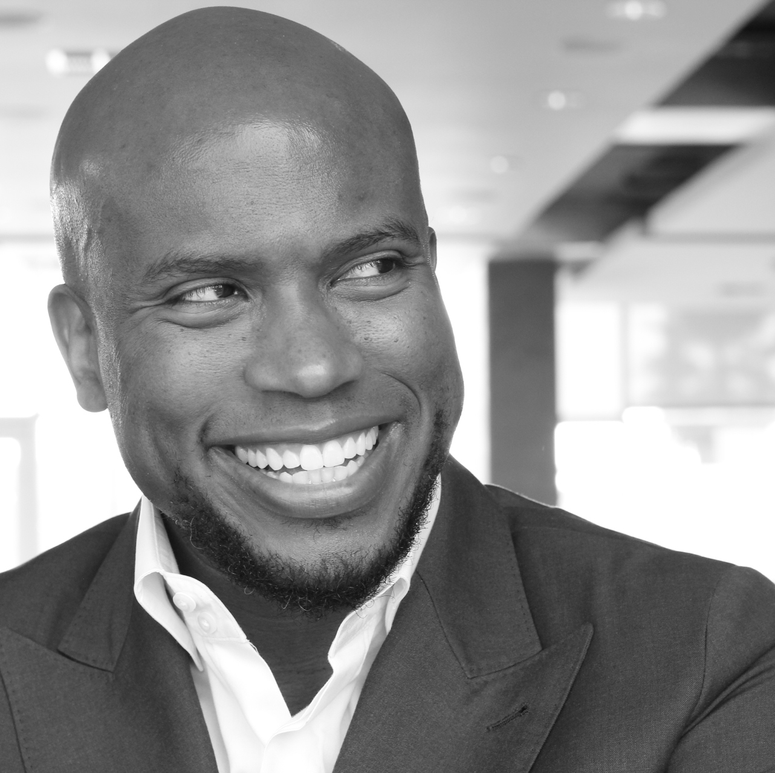


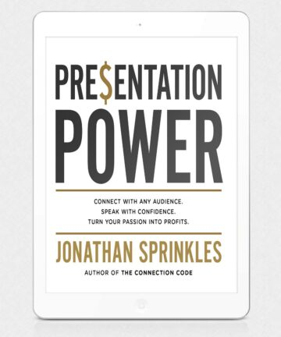
Watch Jonathan Sprinkles: Motivational
He knows the difference between what looks good on paper and what really works in the real world.
Jonathan has a gift for connecting with any audience, relating to them on a personal level, and inspiring them to bring out the best in themselves and the people around them.
Jonathan Sprinkles helps them achieve better productivity, customer loyalty, and increase their bottom-line profits.
Jonathan Sprinkles is a master of creating Magic Moments. He listens to your important details and tailors every presentation to bring your event’s theme to life.
Journal, Entrepreneur and Forbes.
Keynote Topics:
THE POWER OF CONNECTION™
THE CONNECTION CODE™
CREATING A CULTURE OF CONNECTION™
Jonathan Sprinkles
Motivational Leadership
$25,000
*Client is responsible for ground transportation in event city, hotel accommodations and incidentals
for up to two nights

