Slide 1
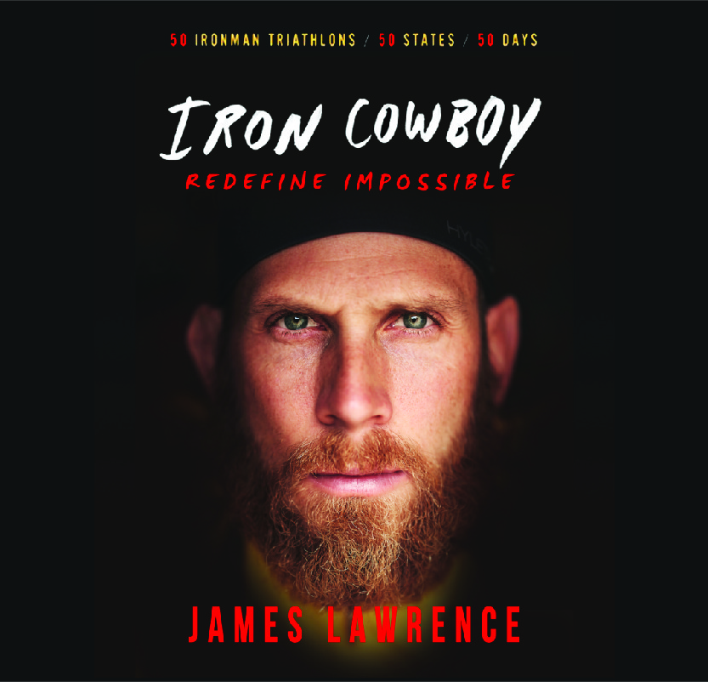
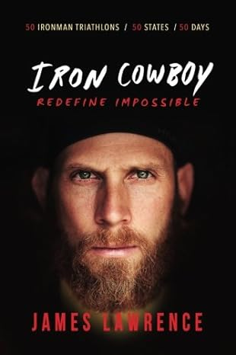
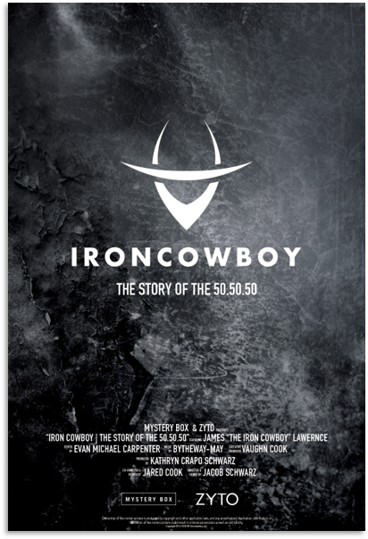
Watch James Lawrence: Breaking endurance barriers, one step at a time
Known as “The Iron Cowboy”, a nickname he received from the public after he started to wear a cowboy hat during the marathon portion of his Ironman races in an effort to be easily recognized by his kids
2X Guinness World Record holder for Most 70.2 Ironman's and Most Full Ironman's
Named one of Sports Illustrated 2017 Fittest 50 alongside Lebron James and Connor McGregor
Author of Redefine Impossible, a memoir sharing stories of his lifetime’s worth of intensely lived experiences
Has completed a 50.50.50, the greatest feat of human endurance, doing 50 long distance triathlons, in 50 consecutive days, through all 50 US states
Pushed his own limits by completing what the team calls the Conquer 100, 100 consecutive full distance triathlons
Named The Most Enduring Man In The World by Success magazine
Keynote Topics:
Redefining Impossible
Doing the Small Things Right
Overcoming Personal Limitations
James Lawrence
The Iron Cowboy | Motivational Speaker
$40,000
*Client is responsible for roundtrip airfare, ground transportation, hotel accommodations and incidentals for up to two nights where required.
*Travels from Lindon, Utah

