Slide 1
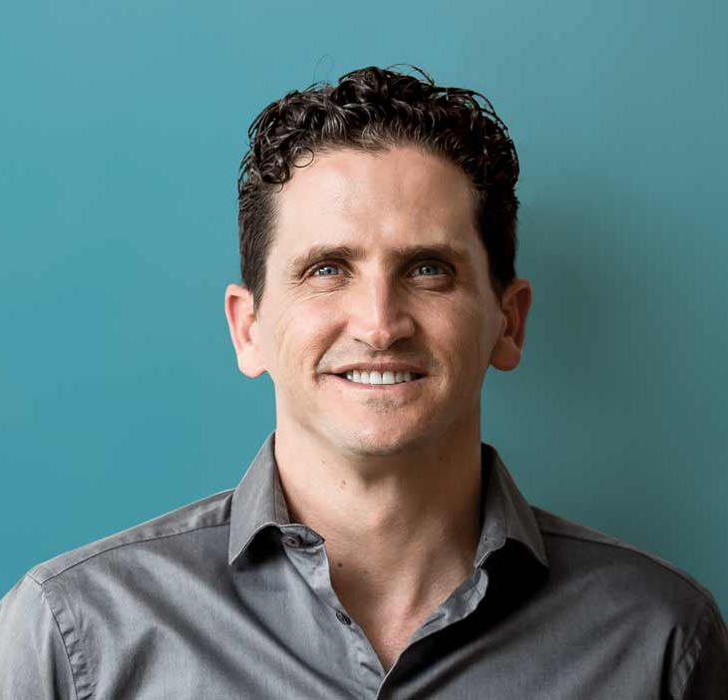




Watch Dr. Justin Cohen: Human Transformation
Watch Dr. Justin Cohen: Bounce Forward
Dr. Justin Cohen is a bestselling author and global speaker and is one of the world’s leading experts in human transformation.
Justin has spoken, trained and coached tens of thousands of people in over forty countries, providing them with powerful tools and insights to achieve lasting breakthroughs in their lives and businesses.
With cutting edge research, humor, entertaining stories and practical take-home tools, Dr. Justin Cohen will inspire and equip your people to unleash their potential.
He has shared the stage with many luminaries including Deepak Chopra, Jack Canfield, John Maxwell and Richard Branson.
KEYNOTE TOPICS:
Bounce Forward Better!
WINNING WITH RELATIONSHIPS - 21 Laws of Influence
The Psychology of Success
What’s your story?
The Power of Connection
Leadership Inside Out
Setting and Scoring Goals
The Psychology of Sales Superstars
Dr. Justin Cohen
Human Transformation Speaker
$12,500
*Client is responsible for ground transportation in event city, hotel accommodations and incidentals
for up to two nights

