Slide 1
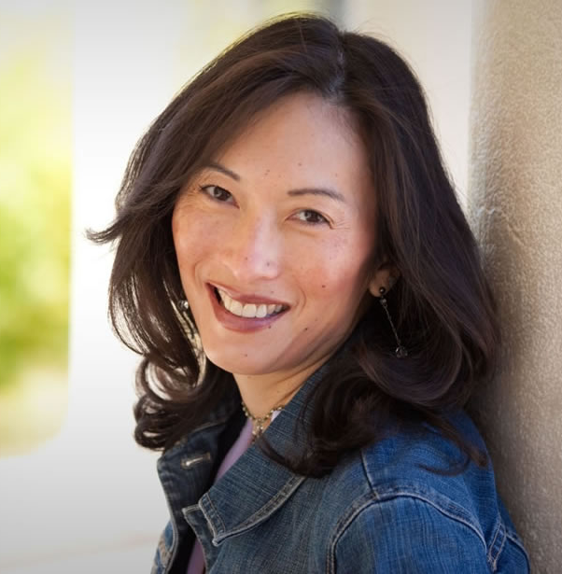
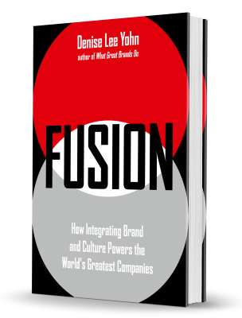
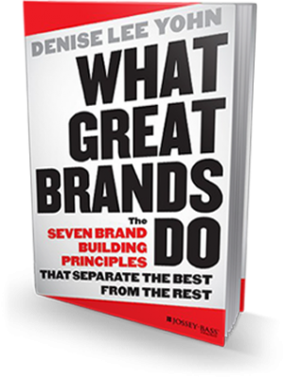

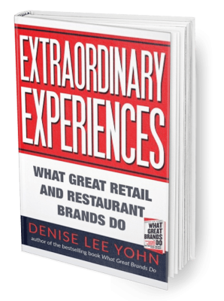
Watch Denise Lee Yohn: Ignite Experience
Watch Denise Lee Yohn: Speaker Showreel
Through her expertise and personal approach, Denise Lee Yohn has become an in-demand keynote speaker inspiring business leaders around the world to build great brands and exceptional organizations.
Denise Lee Yohn reveals the secrets to building a great business that dominates the playing field.
She served as lead strategist at advertising agencies for Burger King, Land Rover, and Unilever and as the marketing leader and analyst for Jack in the Box restaurants and Spiegel catalogs.
Denise is the go-to expert on brand leadership for national media outlets, an in-demand speaker and consultant, and an influential writer.
Outside of her professional roles, Denise counts hiking to Everest Base Camp, dancing with a professional ballet company, and flying a helicopter as some of her greatest life experiences.
Keynote Topics:
Lead To Greatness
THE FUSION FORMULA: Brand + Culture = Results
Brand Leadership: How to Build a Rock Star Brand
DENISE LEE YOHN
Branding Expert
Fee Pending
*Client is responsible for round-trip airfare, ground transportation in event city, hotel accommodations and incidentals for up to two nights

