Slide 1

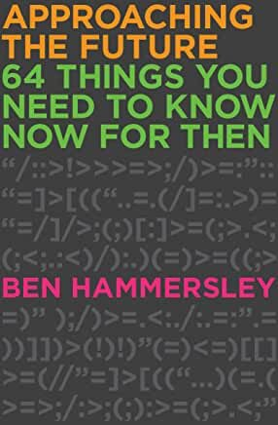

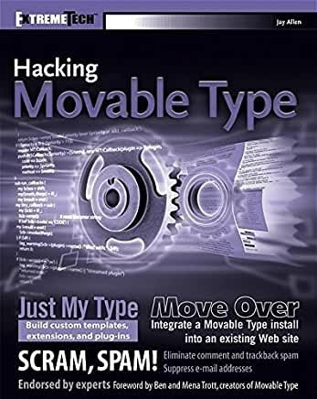
Watch Ben Hammersley: How to predict the future
Recognized as one of the most thought-provoking futurists of our time who has been lecturing to audiences around the globe for over 15 years
Explores the effects of the internet and the digital network on world’s business, political and social atmospheres
Author of 6 books, his latest 64 Things You Need to Know Now For Then is the essential guide to the things we need to know for life in the 21st century
Writer and presenter of the Netflix and BBC TV series, Cybercrimes with Ben Hammersley
Frist specialist correspondent on the internet for The Times [of London] and the Guardian which led to his invention of the term ‘podcast’
Called upon to advise three governments and countless organizations on technology and media including a seat on the European Commission High Level Group on Media Freedom of the European Union in his current position as the Editor-at-Large of UK’s WIRED magazine
Keynote Categories:
Futurist Outlook
Digital Age
Innovation & Global Trends
BEN HAMMERSLEY
Journalist, Technologist and Futurist

